Slide 1
Defect Management

Slide 2
Version Control and Revision History
 | Name | Date
Prepared By | Sneha Kumar | 07-Mar-2019
Reviewed By | Manisha Mane | 07-Mar-2019
Approved By | Nisha Mendonsa | 07-Mar-2019
Version No. | Date | Section Affected | Highlight of Changes
1.0.0 | 07-Mar-2019 | All | Original Version.

Slide 3
Defect logging in identified test management tool

Slide 4
DEFECT MANAGEMENT
Defect Management
What is a defect
Types of defects
Defect life cycle
Defect reporting
Defect management
Defect management Tools

Slide 5
What is a Defect
Any non conformance is a defect
A deviation from specifications, whether missing, wrong, or extra
Anything that causes customer dissatisfactions, whether in the requirements or not

Slide 6
Types of Defect
Functionality Defects
Programming Defects
Logical Defects
Standards
Database Interface
Environmental defects

Slide 7
What is Defect Life Cycle?
Defect life cycle, also known as Bug Life cycle is the journey of a defect cycle, which a defect goes through during its lifetime.
It varies from organization to organization and also from project to project as it is governed by the software testing process and also depends upon the tools used.

Slide 8
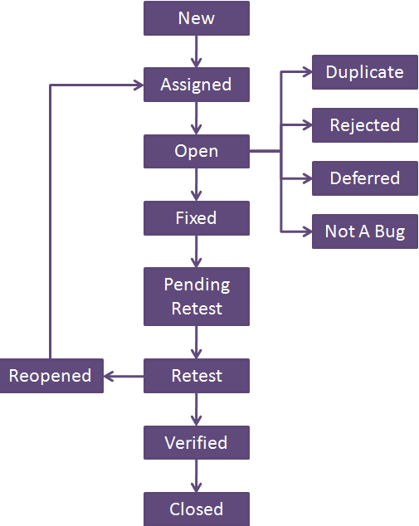

Slide 9
Defect Life Cycle includes following stages:
New: When a defect is logged and posted for the first time. Its state is given as new.
Assigned: Once the bug is posted by the tester, the lead of the tester approves the bug and assigns the bug to developer team. There can be two scenario, first that the defect can directly assign to the developer, who owns the functionality of the defect. Second, it can also be assigned to the Dev Lead and once it is approved with the Dev Lead, he or she can further move the defect to the developer.
Open: Its state when the developer starts analyzing and working on the defect fix.
Fixed: When developer makes necessary code changes and verifies the changes then he/she can make bug status as ‘Fixed’. This is also an indication to the Dev Lead that the defects on Fixed status are the defect which will be available to tester to test in the coming build.
Retest: At this stage the tester do the retesting of the changed code which developer has given to him to check whether the defect got fixed or not.
Once the latest build is pushed to the environment, Dev lead move all the Fixed defects to Retest. It is an indication to the testing team that the defects are ready to test.

Slide 10
Reopened: If the bug still exists even after the bug is fixed by the developer, the tester changes the status to “reopened”. The bug goes through the life cycle once again.
Deferred: The bug, changed to deferred state means the bug is expected to be fixed in next releases. The reasons for changing the bug to this state have many factors. Some of them are priority of the bug may be low, lack of time for the release or the bug may not have major effect on the software.
Rejected: If the developer feels that the bug is not genuine, developer rejects the bug. Then the state of the bug is changed to “rejected”.
Duplicate : If the bug is repeated twice or the two bugs mention the same concept of the bug, then the recent/latest bug status is changed to “duplicate“.
Closed: Once the bug is fixed, it is tested by the tester. If the tester feels that the bug no longer exists in the software, tester changes the status of the bug to “closed”. This state means that the bug is fixed, tested and approved.
Not a bug/Enhancement: The state given as “Not a bug/Enhancement” if there is no change in the functionality of the application. For an example: If customer asks for some change in the look and field of the application like change of color of some text then it is not a bug but just some change in the looks of the application.

Slide 11
Defect Reporting
Need for Defect Reporting:
Used to describe and quantify deviations from requirements
To correct the defect
Report the status of the application
Gather statistics used to develop defect expectations in future applications
Improve the software development process

Slide 12
Who can report a Defect?
Anyone who has involved in software development life cycle and who is using the software can report a Defect.
In most of the cases defects are reported by Testing Team.

Slide 13
Priority and Severity
Severity-The degree of impact casted by the bug on an application.
OR
Severity is the seriousness of the problem.
Priority-Relative degree of precedence given to a bug for its fixation.
OR
Priority is the urgency of fixing a problem.

Slide 14
Priority | Severity
1. Priority defines the order in which the developer should | 1. It is defined as the degree of impact that a defect has on the
2. Priority is categorized into three types •Low •Medium •High | 2. Severity are categorized into five types •Critical •Major •Moderate •Minor •Cosmetic
3. Priority indicates how soon the bug should be fixed | 3. Severity indicates the seriousness of the defect on the product functionality
4.Priority status is based on the customer requirements | 4.Severity status is based on the technical aspect of the product
5.Priority is driven by business value. | 5.Severity is driven by
6.High priority and low severity status indicates, defect have to be fixed on immediate basis but does not affect the application | 6.High severity and low priority status indicates defect have to be fixed but not on immediate basis

Slide 15
Examples of Severity and Priority
High severity and high priority
System crashes in Log-in Page
High severity and Low priority
System crashes on clicking a button.
The page on which the button is located is a part of next release.
Low severity and high priority
Spelling mistake in any company name web site.
Low severity and Low priority
Location of button in any web based application

Slide 16
Defect Report Template
Defect ID: Unique number or name
Description: The summary of the defect
Build version number: The version number of current build, in which test engineers detected this defect.
Feature: The name of module or functionality
Test Case Name: The name of failed test case
Reproducible: Yes/No
(Yes –if the defect appears every time during test execution : attach test procedure or script)
(No –if the defect rarely appears during test execution : attach strong reasons and snap shot)
Severity in terms of functionality.
HIGH/SHOWTOPPER Important & Urgent. Mandatory to resolve & Unable to continue testing without resolving.
MEDIUM/CRITICAL Important but not urgent. Mandatory to resolve but able to continue testing.
LOW/NONCRITICAL Not Important & Not urgent. May or may not resolve but able to continue testing.

Slide 17
Priority: The Importance of the defect to be resolved with respect to the customer (HIGH/MEDIUM/LOW)
Status: New/Re-open
New: Reporting first time
Re-Open: Reporting same defect
Reported by: Name of the Tester
Reported on: Date and time of defect reporting
Assigned To: The responsible person at development side to receive this defect
Suggest fix :( Optional): Reasons to accept and restore these defect.
(By Developers)
Fixed by: Project Manager or Team Leader
Resolved by: Name of programmer

Slide 18
Resolution Type: Accepted, rejected, or postponed
Resolved on: Date of resolving
Approved by: Signature of project Manager

Slide 19
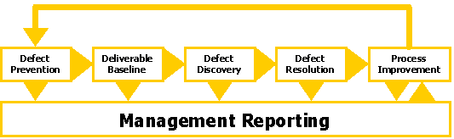
Defect Management Process

Slide 20
Defect Prevention--Implementation of techniques, methodology and standard processes to reduce the risk of defects.
Deliverable Baseline--Establishment of milestones where deliverables will be considered complete and ready for further development work. When a deliverable is baselined, any further changes are controlled.
Defect Discovery--Identification and reporting of defects for development team acknowledgment. A defect is only termed discovered when it has been documented and acknowledged as a valid defect by the development team member(s) responsible for the component(s) in error.
Defect Resolution--Work by the development team to prioritize, schedule and fix a defect, and document the resolution. This also includes notification back to the tester to ensure that the resolution is verified.
Process Improvement--Identification and analysis of the process in which a defect originated to identify ways to improve the process to prevent future occurrences of similar defects. Also the validation process that should have identified the defect earlier is analyzed to determine ways to strengthen that process.

Slide 21
TEST MODELS

Slide 22
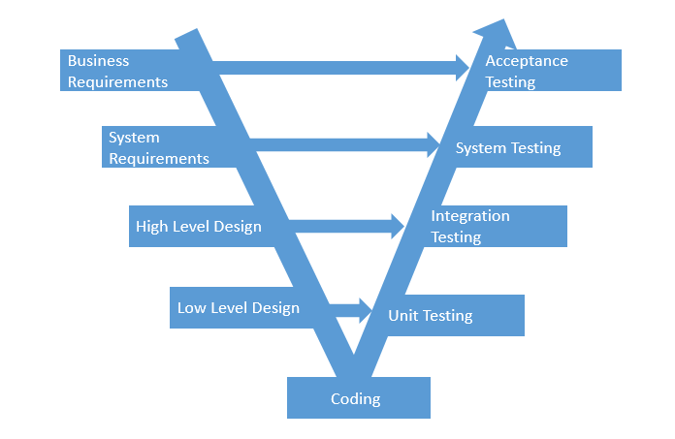
Life Cycle V- Model

Slide 23
V- Model
SDLC Phase
Test Phase
Requirements
1. Build Test Strategy.
2. Plan for Testing.
3. Acceptance Test Scenarios Identification.
Specification
System Test Case Generation.
Architecture
Integration Test Case Generation.
Detailed Design
Unit Test Case Generation

Slide 24
Queries

Slide 25
Thank You.

